Slide 1
Quiz on Lecture 11
Please receive the quiz handout from Cyrille, Oliver, Vincent, Jan
Complete the quiz in silence
Hand the quiz back

Slide 2
Quiz on Lecture 11
Which component in a compute node determines how much data can be loaded & actively worked on at once?
  memory
  CPU
  storage
  cores
If table A has 8 rows, and table B has 6 rows, what is the time complexity from a cartesian join? Assume non-distributed.
  48 join operations
  96 join operations
  24 join operations
  12 join operations
If table A has 8 rows, and table B has 6 rows, what is the time complexity from a cartesian join across 2 nodes each with 4 threads (distributed)?
  3 join operations
  12 join operations
  24 join operations
  6 join operations
What is "big data" in the context of distributed computing?
  More than 1 million rows of data
  More than 1 billion rows of data
  Anything too big to fit into memory on one node
  More than 16GB of memory
Why does Oliver love polars?
  It's fast (written in rust)
  Most data we work with are not "big data", so it's the ideal tool for the job
  If data size grows (e.g. more than 16gb), can scale vertically (i.e. add more memory to VM)
  all of the above
Which two components in a compute node are most similar to each other?
  memory & storage
  memory & CPU
  storage & CPU
  nigerian jollof rice & spicy risotto

Slide 3
Quiz on Lecture 11
Which component in a compute node determines how much data can be loaded & actively worked on at once?
  memory
  CPU
  storage
  cores
If table A has 8 rows, and table B has 6 rows, what is the time complexity from a cartesian join? Assume non-distributed.
  48 join operations
  96 join operations
  24 join operations
  12 join operations
If table A has 8 rows, and table B has 6 rows, what is the time complexity from a cartesian join across 2 nodes each with 4 threads (distributed)?
  3 join operations
  12 join operations
  24 join operations
  6 join operations
What is "big data" in the context of distributed computing?
  More than 1 million rows of data
  More than 1 billion rows of data
  Anything too big to fit into memory on one node
  More than 16GB of memory
Why does Oliver love polars?
  It's fast (written in rust)
  Most data we work with are not "big data", so it's the ideal tool for the job
  If data size grows (e.g. more than 16gb), can scale vertically (i.e. add more memory to VM)
  all of the above
Which two components in a compute node are most similar to each other?
  memory & storage
  memory & CPU
  storage & CPU
  nigerian jollof rice & spicy risotto

Slide 4
Designing and Deploying
end-to-end
Production Grade ML Applications
Lecture 12: AI Agents
October 2025
Jan Ravnik & Oliver Angélil

Slide 5
Contents of three AI Agents Lectures:
Lecture 12: Fundamentals of LLMs and Basic Chatbot Construction
  Introduction to LLMs: History, architecture and training
  API calls and text completions
  Prompt engineering techniques
  Structured output and function calling
Lecture 13: Advanced Techniques with LangChain and React Agents
  What is agentic AI?
  LangChain modules for app development
  React agents, reasoning and decision-making
  Stateful agents
Lecture 14: Complex Systems and Swarm Intelligence
  LangGraph for multi-agent systems
  Swarm intelligence
  Complex AI agents and collective behavior
this lecture

Slide 6
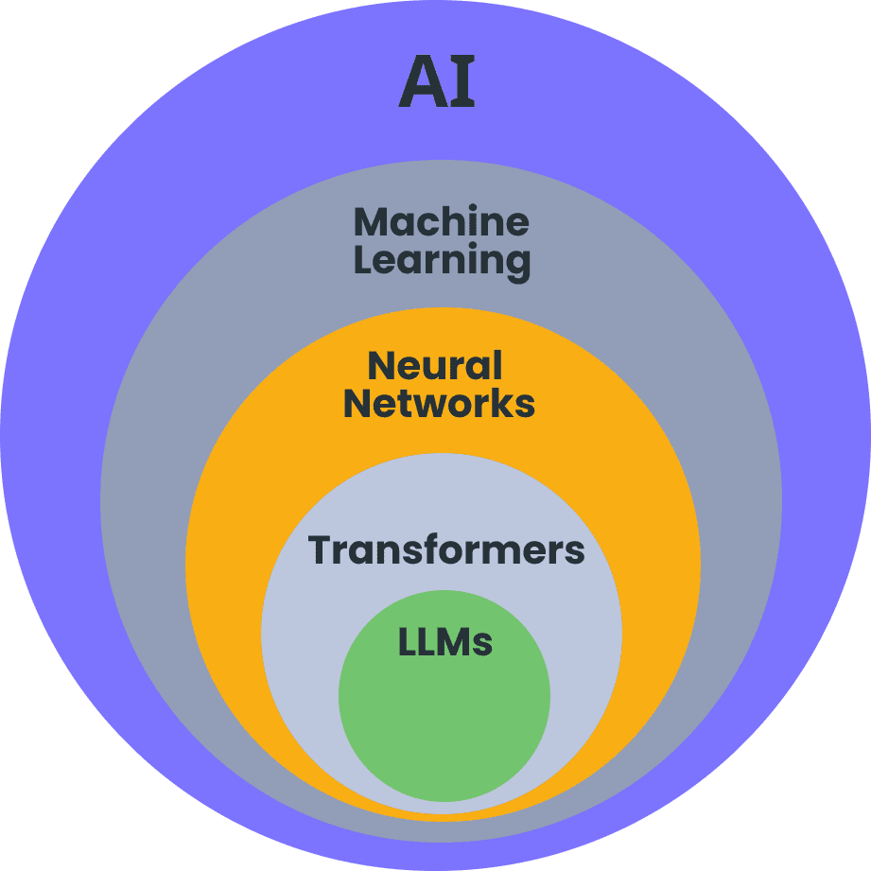
Introduction to LLMs
Large Language Models (LLMs): Neural network systems tasked with language modelling
Key characteristics:
Take text as input and output more text
Trained on trillions of tokens of text data
Capable of understanding and generating human language
Demonstrate emergent abilities not explicitly programmed
Exhibit few-shot and zero-shot learning capabilities
Input (text)
LLM
Output (text)

Slide 7
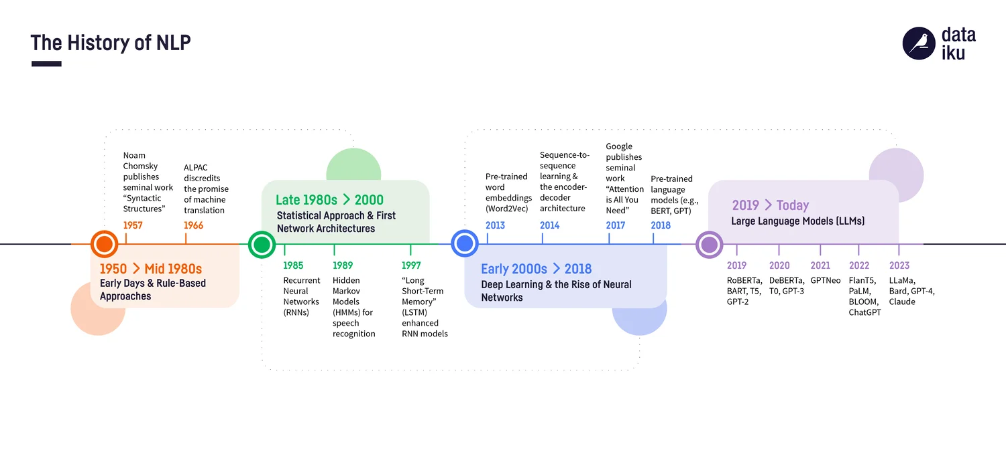
NLP to LLM Evolution
https://blog.dataiku.com/
Notes:
Early NLP (1950s-2000s):
Rule-based systems: Handcrafted grammar rules and pattern matching
Statistical methods: Probabilistic models like n-grams
Shallow ML: Support Vector Machines, Naive Bayes classifiers
Neural NLP revolution (2010-2017):
Word embeddings (Word2Vec, GloVe)
Recurrent Neural Networks (RNNs, LSTMs, GRUs)
Limited context window and vanishing gradient problems
Transformer breakthrough (2017-present):
Attention mechanisms replace recurrence
Parallel processing of entire sequences
Self-attention enables global context understanding
Foundation for all modern LLMs (BERT, GPT, T5, etc.)

Slide 8
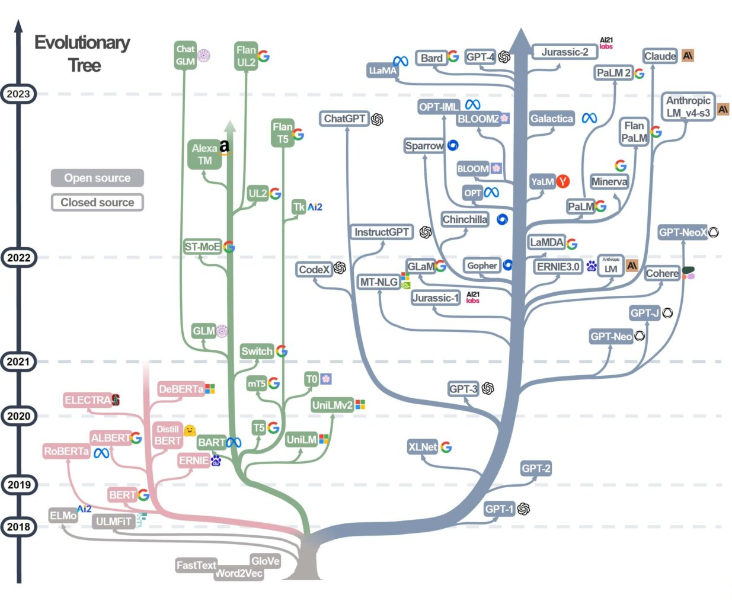
Key Milestones
in LLM
Development
https://admantium.com/blog/llm01_introduction_to_llms/
Notes:
2017: "Attention is All You Need" paper introduces the Transformer architecture
2018: BERT by Google - Bidirectional training revolutionizes NLP benchmarks
2018: GPT-1 by OpenAI - 117M parameters, initial generative transformer
2019: GPT-2 by OpenAI - 1.5B parameters, improved text generation
2020: GPT-3 by OpenAI - 175B parameters, few-shot learning capabilities
2022: ChatGPT release - Conversational interface to GPT models
2023: GPT-4 by OpenAI - Multimodal capabilities, improved reasoning
2023: Open-source models gain traction (Llama, Mistral, Falcon)
2023-2024: Specialized and domain-adapted models emerge

Slide 9
LLM Architecture
Input (Text)
Token embeddings
Do the magic
Predict the next token
Output (Text)
Matrix operations (numbers!)
Text to numbers
Numbers to text
Cats are
cool
Token = some number of characters:
Single letter, full word, punctuation…
Tokens have different lengths and are based on what commonly appears on the text.
Word (token) embeddings

Slide 10
LLM Architecture - Token embeddings
Cats
0.23, -0.78, … , 0.46
Queen
King
are
-0.73, 0.34, … , 0.13
Woman
Man
cool
0.11, -0.25, … , -0.83
King - Man + Woman = ?

Slide 11
LLM Architecture - Token embeddings
Cats
0.23, -0.78, … , 0.46
Queen
King
are
-0.73, 0.34, … , 0.13
Woman
Man
cool
0.11, -0.25, … , -0.83
King - Man + Woman = Queen

Slide 12
LLM Architecture - Token embeddings
Cats
0.23, -0.78, … , 0.46
Queen
King
are
-0.73, 0.34, … , 0.13
Woman
Man
cool
0.11, -0.25, … , -0.83
King - Man + Woman = Queen
Doctor - Man + Woman = ???

Slide 13
LLM Architecture - the magic
Historically:
RNNs, LSTMs - process words sequentially, forgetting long context.
The LLM magic (transformers):
Positional encodings: Preserve sequence order information
Multi-head attention: Process relationships between tokens - process all tokens at the same time
Feed-forward networks: Transform representations
Layer normalization: Stabilize training
Input (Text)
Token embeddings
Do the magic
Predict the next token
Output (Text)

Slide 14
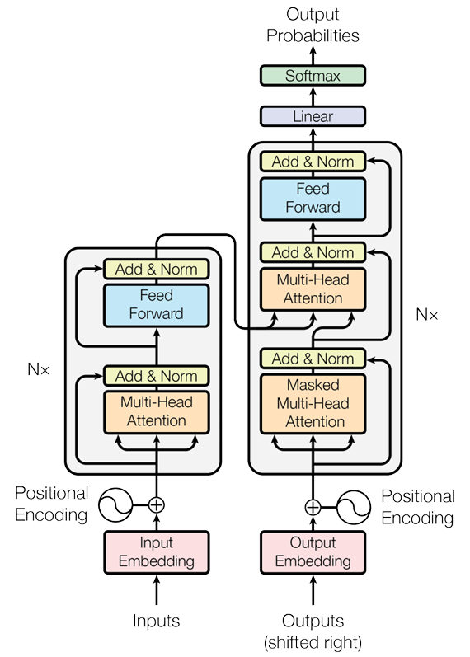
LLM Architecture - Encoder and Decoder
Key components:
Token embeddings: Convert words to vector representations
Positional encodings: Preserve sequence order information
Encoder: Processes input text into contextual representations
Decoder: Generates output text based on encoded representations
  Multi-head attention: Process relationships between tokens
  Feed-forward networks: Transform representations
  Layer normalization: Stabilize training
Types of transformers:
Encoder-decoder models (T5): Translation and transformation
Encoder-only models (BERT): Understanding tasks
Decoder-only models (GPT): Generation tasks
Attention is all you need https://arxiv.org/abs/1706.03762

Slide 15
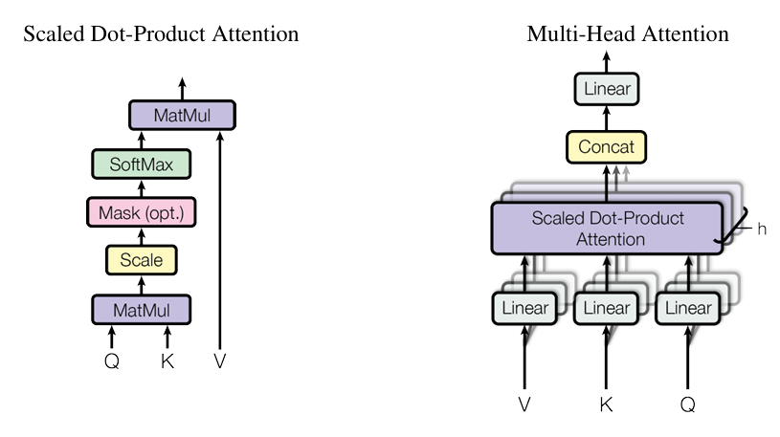
LLM Architecture - Attention Mechanism
Attention:
The core innovation enabling modern LLMs
Each token attends to all other tokens in the sequence
Attention scores measure relevance between token pairs
Benefits:
Handles long-range dependencies in text
Resolves ambiguity through context
Creates rich, contextual token representations
In practice:
Clever way of doing vector/matrix multiplication
Many parallel attention heads
# Simplified attention calculation (pseudocode)
def self_attention(sequence):
# Create query, key, value projections
Q = sequence @ W_query
K = sequence @ W_key
V = sequence @ W_value
# Calculate attention scores
scores = Q @ K.transpose() / sqrt(d_k)
# Apply softmax to get probabilities
attention_weights = softmax(scores)
# Get weighted sum of values
context_vectors = attention_weights @ V
return context_vectors

Slide 16
Attention Mechanism
Attention:
The core innovation enabling modern LLMs
Each token attends to all other tokens in the sequence
Attention scores measure relevance between token pairs
Benefits:
Handles long-range dependencies in text
Resolves ambiguity through context
Creates rich, contextual token representations
In practice:
Clever way of doing vector/matrix multiplication
Many parallel attention heads

Slide 17
Training and Post-Training LLMs
Modern LLMs are pre-trained using trillions of words (entire web!)
Enormous compute power: thousands of GPUs running for weeks or months, costing millions of dollars.
Despite this, pre-trained base models have limitations:
  No knowledge of recent events after their data cutoff.
  Can generate plausible-sounding but incorrect or nonsensical answers (“hallucinations”).
  Poor at following nuanced instructions or aligning with user expectations (e.g., tone, safety, task performance).
The Role of Post-Training
Goal: Refine and align the base LLM with specific tasks, domains, or safety requirements.
Addresses gaps such as factual accuracy, user intent, and ethical alignment.
Input:
What is the capital of france?
Output:
What is the capital of Germany?
What is the capital of Spain?
Base model
Input:
What is the capital of france?
Output:
The capital of France is Paris.
Instruction fine-tuned model

Slide 18
Post-Training LLMs
Post-Training Data is smaller and more curated.
Includes task-specific examples, question-answer pairs, user demonstrations, or preference data.
Quality and relevance are more important than volume.
Common Post-Training Methods
Supervised Fine-Tuning (SFT):
  Labeled datasets with correct outputs for given inputs.
  Improves performance on targeted tasks (chatbots, translation, summarization).
Reinforcement Learning from Human Feedback (RLHF):
  Model generates outputs, humans rank or score them.
  These preferences train a reward model, which is then used to further train the LLM via reinforcement learning.
  Drives alignment with human values and improves response helpfulness and safety.
Parameter-Efficient Fine-Tuning: LoRA and Similar Approaches
Allows effective fine-tuning by updating a small subset of model parameters, not the whole model.
Drastically reduces compute and memory requirements, making customization practical for more users.

Slide 19
Practical part

Slide 20
API Calls with LLMs
LLMs are accessed through APIs, facilitating integration into applications.
Steps:
Get API key (typically you pay for it)
set up environment
make requests
handle responses.
Uses:
Auto-completing sentences, generating creative content, question answering.
Build large scale apps that can automate LLM calls
import google.generativeai as genai
# Set up API authentication
genai.configure(api_key="YOUR_API_KEY")
model = genai.GenerativeModel("models/gemini-2.0-flash-lite")
response = model.generate_content("What is the capital of France?")
print(response.text)
Please go to https://aistudio.google.com/app/api-keys and create your API key, so you can call an LLM. This should be free of charge.

Slide 21
Introduction to Prompt Engineering
"Tell me about climate change."
Prompt engineering: The art and science of crafting effective inputs for LLMs
The better the prompt, the better the response
  Think about how you would ask a person
Impacts output quality and relevance
Compensates for model limitations
Prompt engineering process:
Draft initial prompt
Test and analyze response
Refine prompt based on results
Iterate until satisfactory
"Explain the causes and effects of climate change in 3-4 paragraphs. Include scientific consensus, major contributing factors, and potential mitigation strategies. Use clear language suitable for a high school student."
"You are an environmental science educator creating content for a high school classroom. Write a 3-4 paragraph explanation of climate change that:
1. Explains the greenhouse effect and how human activities contribute to it
2. Describes 3 major observed and projected impacts of climate change
3. Outlines 2-3 significant mitigation strategies being implemented globally
Use data-supported facts while keeping the language accessible to 10th-grade students."

Slide 22
Techniques in Prompt Engineering
Classify the sentiment of the sentence as Positive or Negative, as shown in the examples.
Example 1:
Sentence: I love this new phone!
Sentiment: Positive
Example 2:
Sentence: The service was terrible.
Sentiment: Negative
Please classify the following sentence:
Sentence: The restaurant was fantastic.
Sentiment:
Role assignment: "You are an expert in..."
Few-shot learning: Provide examples of desired outputs
Chain of thought: "Think step by step..."
Specific instructions: Format, length, style, audience
Contextual framing: Set scenarios or constraints
When adding data to your prompt use delimiters
Advanced techniques (some are a good starting point for agents):
  Self-criticism: "Review your answer for errors"
  Alternative perspectives: "Consider different viewpoints"
  Structured reasoning: "First... Second... Finally..."
  Explicit constraints: "Do not mention..."
Summarize the key findings from the research paper. The paper is enclosed in <paper> tags.
<paper>
Recent studies show that drinking tea reduces stress and improves focus.
</paper>
Summary:

Slide 23
Structured Output from LLMs - Intro
Please extract the date of birth from the given document:
<document>
Actual document text…
</document>
Challenges with raw LLM outputs:
Inconsistent formatting
Difficult to parse programmatically
May include unnecessary explanations
4. 5. 1991
4. May 1991
5. 4. 1991
The date of birth is 4. May 1991
Improved prompt:
Please extract the date of birth from the given document: <document>Actual document text…</document>
Return it in the following format: dd-mm-yyyy. Don’t write anything else in the output

Slide 24
Structured Output from LLMs
Improved prompt:
Please extract the date of birth from the given document:
<document>
Actual document text…
</document>
Return it in the following format: dd-mm-yyyy. Don’t write anything else in the output
Instead of asking the LLM to do something, force it:
Allow the LLM to only output pre-determined tokens:
  Date can only start with 0, 1, or 2.
Two ways of doing this:
  Iteratively - just re-prompt the LLM if the output is incorrect (wasteful!)
  Edit the LLM itself to introduce constraints
  Luckily, libraries do that for you.
Benefits of structured outputs:
Predictable format:
  Use it as input to functions
  Use JSON, XML, CSV for more complex tasks
Direct integration with application logic
Reduced post-processing complexity
04-05-1991
04-05-1991
04-05-1991
The date of birth is 04-05-1991

Slide 25
Structured Output from LLMs
Aspect | Prompt Engineering | True Structured Output
Format Guarantee | ❌ Can return markdown/text | ✅ Always pure JSON
Parsing Reliability | ❌ May fail with json.loads() | ✅ 100% parseable
Field Validation | ❌ Fields may be missing/wrong | ✅ Schema-enforced
Type Safety | ❌ Manual validation needed | ✅ Automatic type checking
Production Ready | ⚠️ Requires error handling | ✅ Bulletproof

Slide 26
Function Calling with LLMs (dependant on structured output)
Input (Text)
LLM
Parse the output and use logic to decide what to do next
Do stuff…
Output (Text)
- Access to tools
- Structured
output
Can be as simple as “if” clauses
Call whatever tool the logic decides

Slide 27
Function Calling with LLMs (dependant on structured output)
Using LLMs to determine when and which functions to call
Process:
Define function signatures (name, parameters, descriptions)
Send to LLM with user query
LLM determines if function should be called
LLM generates appropriate parameter values -> using structured output
Application executes function with parameters
Applications:
API integrations (weather, booking, search)
Database queries
External tool orchestration
Structured data extraction
response = openai.Completion.create(
engine="text-davinci-003",
prompt="Calculate the sum of 123 and 456",
max_tokens=10
)
result = response.choices[0].text.strip()
print("Result:", result)

Slide 28
Chatbots
No history
Hi, I am Jan
Hi, Jan! How can i help you?
What is a chatbot?
A program that interacts with users through text or voice conversations.
Works by sending repeated API calls to a language model with each user message.
Needs to track information (memory) from earlier in the conversation to respond coherently.
What is my name?
Sorry, I don’t have access to your personal information. What else can i help you with?
With history
Hi, I am Jan
Hi, Jan! How can i help you?
What is my name?
Your name is Jan. What can i help you with?

Slide 29
Tasks
Task 1: Set up your env
Task 2: Create a simple API call to the chatbot
Task 3: Prompt engineering
Task 4: Structured output
Task 5: Function calling
Task 6: Chatbot

